Slide 1

Data Anlytics Solution : XYZ Corp
By- Ashish Rahangdale

Slide 2
Datasets
Base Data(Raw Files) Bronz Layer
Calendar.csv : listing_id,date,available,price
Listing.csv : Detail of offerings on the XYZ system by different hosts.
Listings_details.csv : Details of the offerings
Neighbourhood.csv : Neighbourhood detail
Reviews.csv : Reviews received by the listing.
Reviews_details.csv : Detailed reviews.
Refined Dataset gold layer
xyz_gold.market_trends
xyz_gold.property_type_statistics
xyz_gold.neighborhood_statistics
xyz_gold.user_engagement
Refined Dataset Silver layer
xyz_silver.listing
xyz_silver.neighbourhoods
xyz_silver.reviews
xyz_silver.ListingDates

Slide 3
Report Type
Heat Map : A Report showing prices in an area represented in a heat map where red can show higher price.
Market Trend: Consideration of implementing machine learning models to predict future market trends, recommend listings to users, or identify anomalies in your data.
Property Type Statistics : To analyze which types of properties are more popular.
Neighborhood Statistics : To understand which neighborhoods are in demand.
User Engagement: Analysis of customer behavior to see which properties are preferred by different class of customers.

Slide 4
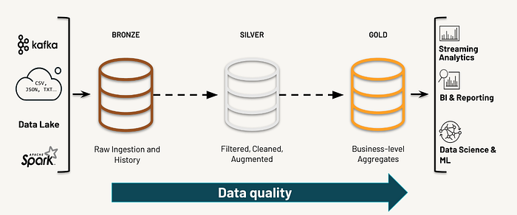
Architecture
Considering the production scenario, it’s advisable to have the process of data onboarding, data quality implementation and business case specific value creation should be modeled in a process.
Databricks prescribes using Deltalake and Medallion architecture.
Bronze – Raw data with CDC
Silver – Data quality and entrerprise view.
Gold – Consumption ready, project specific data
For gold layer we can pick a star schema to create different reports.

Slide 5
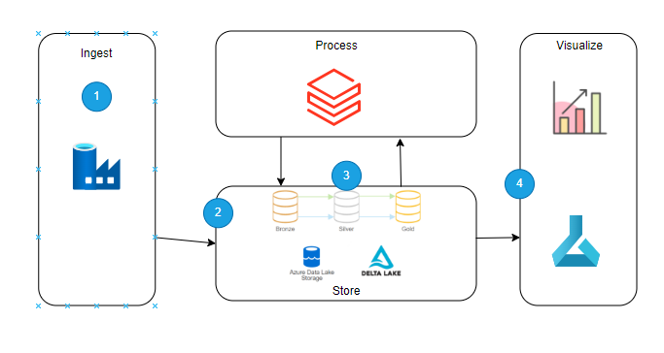
Technology Stack
Azure is the default choice for cloud provider.
Ingest: Data factory is utilized for ingesting data from source, depending on type/frequency of data other service can also be utilized.
Process: Azure Databricks loads the data into optimized, compressed Delta Lake tables or folders in the Bronze layer in Data Lake Storage
Storage: Streaming, scheduled, or triggered Azure Databricks jobs read new transactions from the Data Lake Storage Bronze layer. The jobs join, clean, transform, and aggregate the data before using ACID transactions to load it into curated data sets in the Data Lake Storage Silver and Gold layers in Azure datalake storage
Visualize : Depending on the use case, a reporting platform such as PowerBI can be used, where data trends and insights can be visualized.

Slide 6
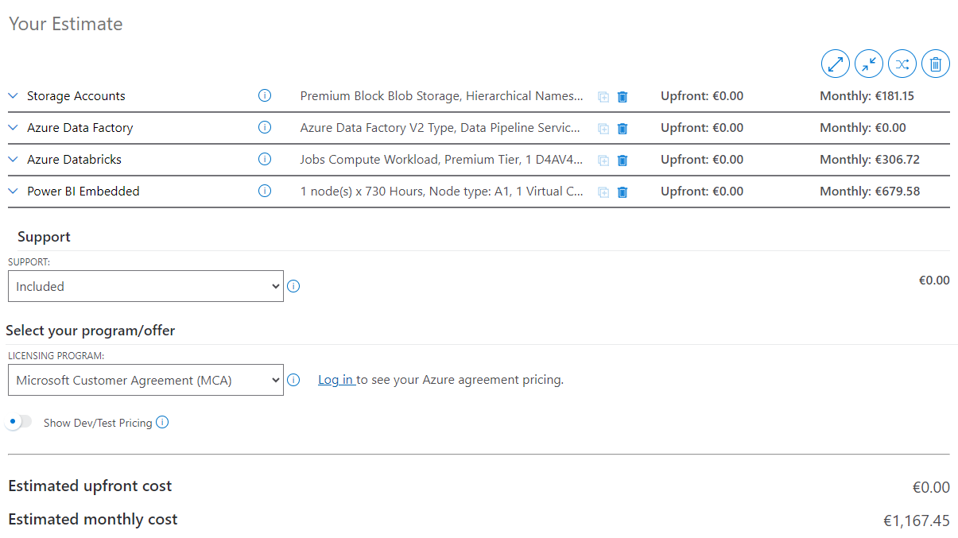
Cost Estimation of cloud infra

Slide 7




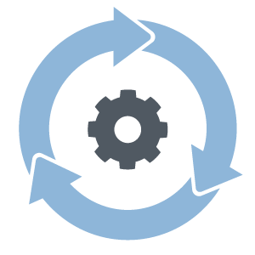

CI/CD
Code
Unit Test
Static Code
Analysis
Source Control
Continuous integration
Continuous Deployment
Approach
Code : Developer writes code
Unit Test : Testing the developed feature
Static code analysis : Using tools like SonarQube
Source control : Git or Azure DevOps Server
Continuous integration : Post build Merging with the Master branch
Continuous deployment : Deployment to production environment
Highlights
Shift Left approach to identify issues early in the chain.

Slide 8
References
Microsoft Azure Documentation
https://azure.microsoft.com/en-us/pricing/calculator/
https://learn.microsoft.com/en-us/azure/architecture/browse/
https://azure.microsoft.com/en-us/products/devops#overview
https://www.databricks.com/glossary/medallion-architecture
https://www.sonarsource.com/products/sonarlint/

